Slide 1
Stars Part I:
Star Categorization
What are the different types of stars
Objectives:
Determine where a star gets energy from
Classify stars based upon: luminosity, size, and temperature
State the four main types of stars

Slide 2
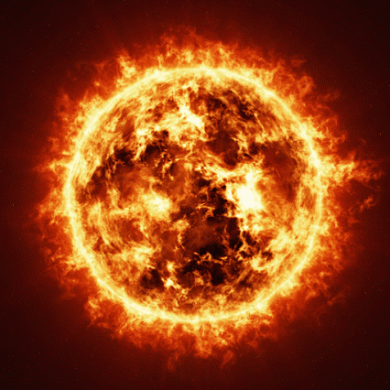
What is a star?
You probably already have a decent idea of what a star is, but…
A star is a luminous ball of gas, primarily hydrogen and helium gas.
The Sun is the closest star to Earth, but looking into the night sky you can see millions, sometimes billions, in the distance.

Slide 3
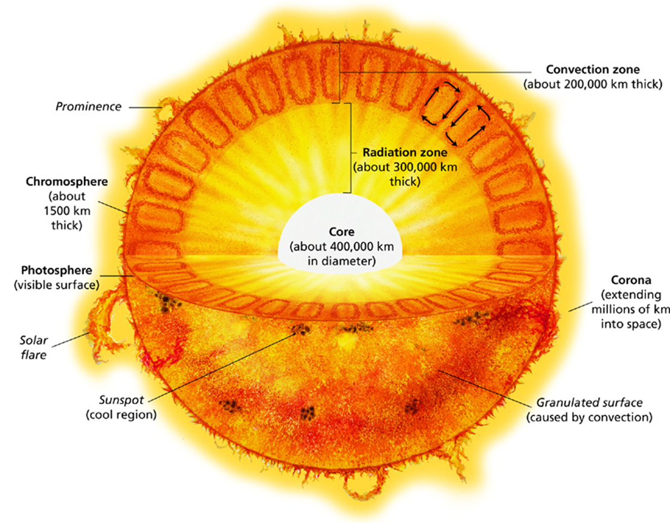
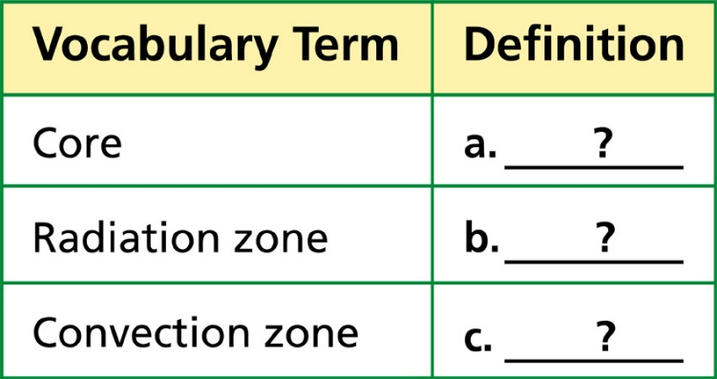
What is the composition of a star?
a. The central region of the sun where fusion occurs
A region of highly compressed gas where energy is transferred mainly by radiation
The outer layer of the sun’s interior, were energy is transferred mainly by convection

Slide 4
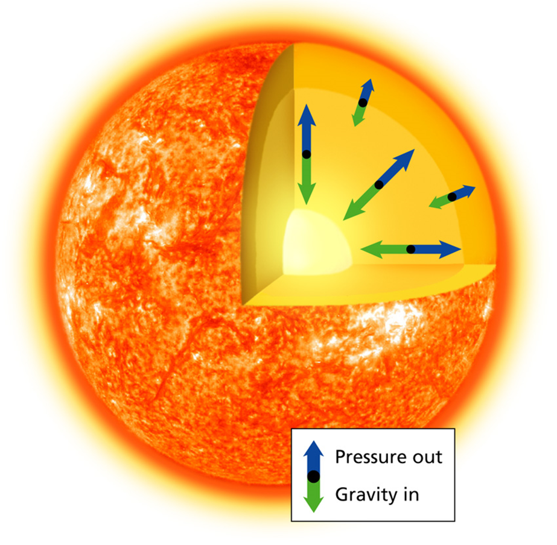
WHAT ARE THE FORCES IN A STAR?
There are two main forces at odds in a star.
First, GRAVITY, which is the force that causes two masses to pull towards each other. Matter has mass and mass creates gravity. The more mass, the more gravity is induced.
Second, pictured as “pressure out” here, is FUSION REACTIONS. When atoms are smashed together, their nuclei are eventually forced to combine into larger nuclei, releasing energy in the process.
Stable suns, like ours right now, are stable because these two forces are in balance.
But this balance doesn’t last forever. It will eventually be thrown off.

Slide 5

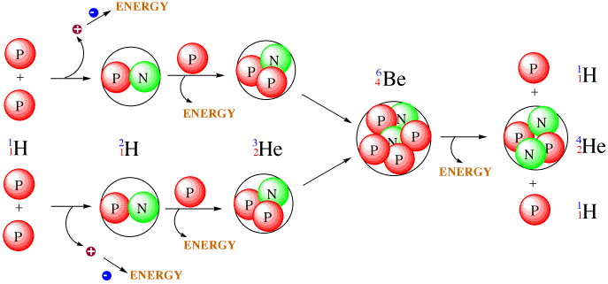
What causes a STAR to burn and emit light?
The gravity of stars cause fusion reactions in the core and these fusion reactions produce the light and heat in a star.
  The two main forces are working to produce it’s size, temperature, and luminosity, depending upon its initial mass.
  Gravity causes the atoms in the nebula cloud to squeeze in on each other and as the squeezing increases, temperature and pressure increases.
  When pressure and temperature get high enough, atoms of the most basic of element, hydrogen, are fused together eventually forming helium, releasing extreme energy in the process.
The light given off by stars are photons, a result of this energy escaping.
Light & Heat

Slide 6
Stellar Classification
Stars come in a lot of forms.
Stars can be categorized several ways:
  Surface Temperature = How hot they are believed to be burning.
  Luminosity = How much light they put off.
  Solar Radii = How massive they are when they form.

Slide 7

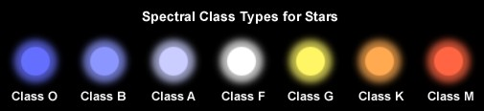
Solar Surface Temperature
What is the temperature of our sun?
  Somewhere between 5000 & 6000K.
  We know that stars are made of hydrogen and helium and depending on how hot these elements are burning will determine the color of the star.
  Think of a candle flame.
  Where is the candle the hottest?
  Associate temperature of a star with a candle.
  We compare the light given off by other stars against our own sun to measure the relative difference in color to determine the temperature.
    Blue stars are hotter than yellow stars.
    Red stars are the coolest.
Coolest
Hottest
The unaided eye can see some differences, but our much improved technology allows us to see things much more accurately so we can tell minute differenced between the temperatures of other stars.

Slide 8
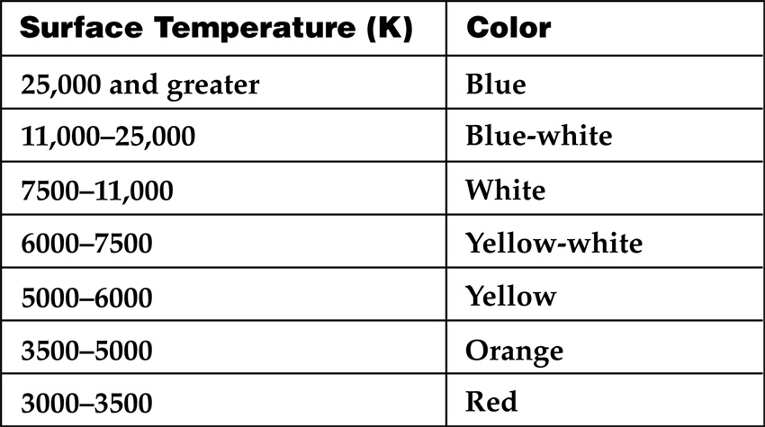
Classification of Stars
Have you ever looked at the stars
and realized that not all stars are
white? Stars can be red, orange,
yellow, white, or blue. Stars are
classified according to their surface
temperature, which determines
each star’s color. Use the data in
the table to help you answer the
questions below.
What is K?
The surface temperature of the sun is 5800 K. What color is the sun?
Sirius, the brightest star in the night sky as seen from Earth, has a surface
temperature of approximately 10,000 K. What color would you expect Sirius to be?
Another star, Betelgeuse, is red in color. Estimate the surface temperature
of Betelgeuse.
KELVIN, an SI unit for temperature, similar to Celsius but off by 373 degrees
YELLOW
WHITE
3000-3500K

Slide 9
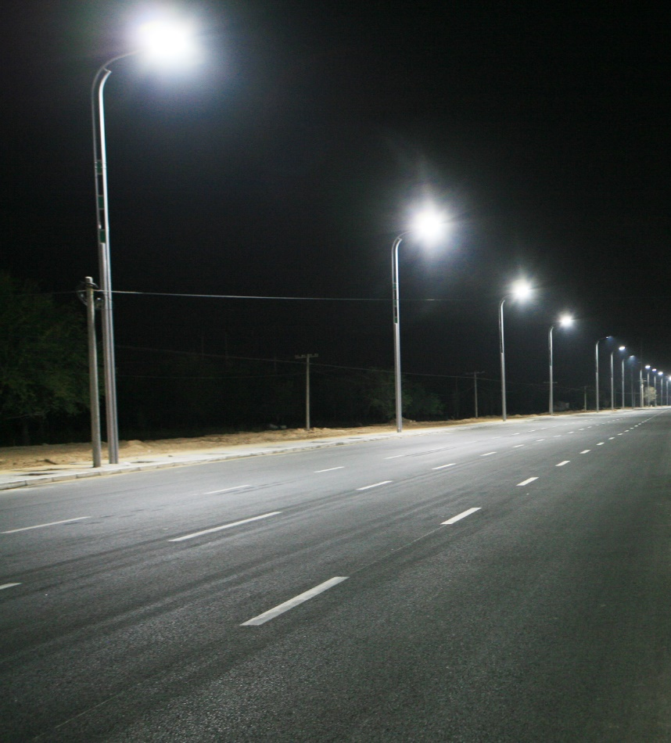
Luminosity
Luminosity is the total amount of energy (light) emitted by a star, galaxy, or other astronomical object.
It is related to brightness, but there are complications.
Apparent brightness: How bright something appears to be. Things that are closer to us appear brighter than those things that are really the same brightness but farther away.
Think of street lights. They are all the same brightness but the ones closer are brighter than those farther away.
However, scientists have realized that some stars appear brighter than others even though they are farther away.
This is because their absolute brightness (the measure of the true brightness of a star) is much larger than their apparent brightness.
Scientists can find the absolute brightness of a star if they know how far a star is away (using the Doppler Effect or Parallax for examples) and its apparent brightness.

Slide 10
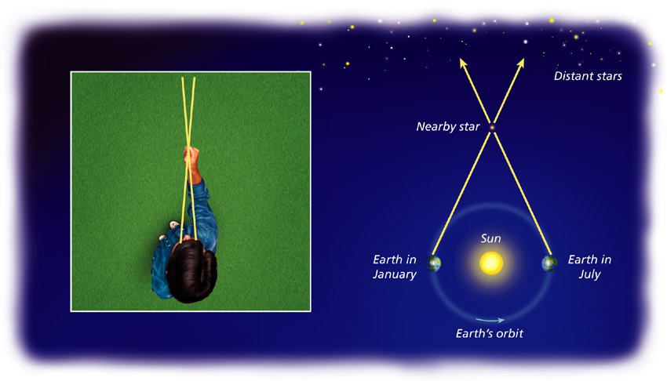


Parallax: How we find the distance to the stars

Slide 11

Solar Radii
Radius is the distance from the center of a circle to the outside.
For a star, this is generally how big we have determined a star to be.
If we know the temperature of a star and its absolute brightness, we can determine its solar radius.
Knowing how near or far the star is also aids in determining its size.

Slide 12
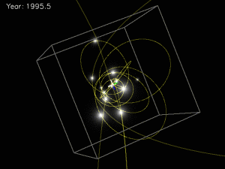
A Star’s Mass
Mass is a measure of how much matter is in an object.
Essentially, it’s a measure of how many atoms it has.
Observed and predicted positions of 13 stars close to the galactic center around Sgr A*.
Credit: Keck/UCLA Galactic Center Group/Cosmus
This is difficult to measure directly because we would need to know information like density to truly determine a star’s mass.
Fortunately, there are brilliant scientists, such as Newton, Galileo, and Einstein, that understood how gravity works and used it to develop a theory on how the mass of astrological bodies influence one another through their gravitational pull.
What we now know is that the gravitational interactions observed in celestial bodies explains its influence on orbits and can give us information that will help us determine just how MASSIVE a star is.
Gravity increases when mass increases and distance decreases.

Slide 13
HR Diagrams
Hertzsprung and Russell both independently observed that stars can be categorized by their surface temperature, color, or absolute brightness in the early 1900s.
Taken together, astronomers have developed a diagram showing how these three categories can be synthesized into one chart, called the Hertzsprung-Russell Diagram…
or H-R Diagram for short.
H-R diagrams are used to estimate the sizes of stars and their distances.
WHY???
This information is plotted on the H-R diagram to infer how stars change over time.
Knowing how stars fit into the diagram allows us to predict how they will ultimately end up; as supernovas, white dwarfs or black holes…

Slide 14
Observe your H-R Diagrams.
What do each of these mean?
How many axes are on the diagram?
What do each mean?
Annotate these on your diagrams.
Look at the scale of the axes. What do you notice?
What is luminosity?
What does the “1” mean?
What does the “10²” mean?
Look at surface temperature. How hot is our sun?
What is K?
What does solar radii mean?
Why are there different lines going diagonally?

Slide 15
In Class Practice:
Graph the position on the H-R Diagram for…
Rigel
Betelgeuse
Altair
Aldebaran
Sirius B

Slide 16
Rigel
Betelgeuse
Now label (in the far right column of the data table…)
Rigel = Super Giant
Betelgeuse = Super Giant
Altair = Main Sequence
Aldebaran = Giant
Sirius B = White Dwarf
Aldebaran
Altair
Sirius B

Slide 17
Independent Practice
Using the data table and blank H-R diagram, plot the position for each of the stars listed in the table.
Mark your stars in their correct positions using pencil first (so if you make a mistake you can correct it).
Once completed, analyze the positions of the stars and see if you can identify the pattern.
You have 15 minutes.
Rigel
Betelgeuse
Aldebaran
Altair
Sirius B

Slide 18
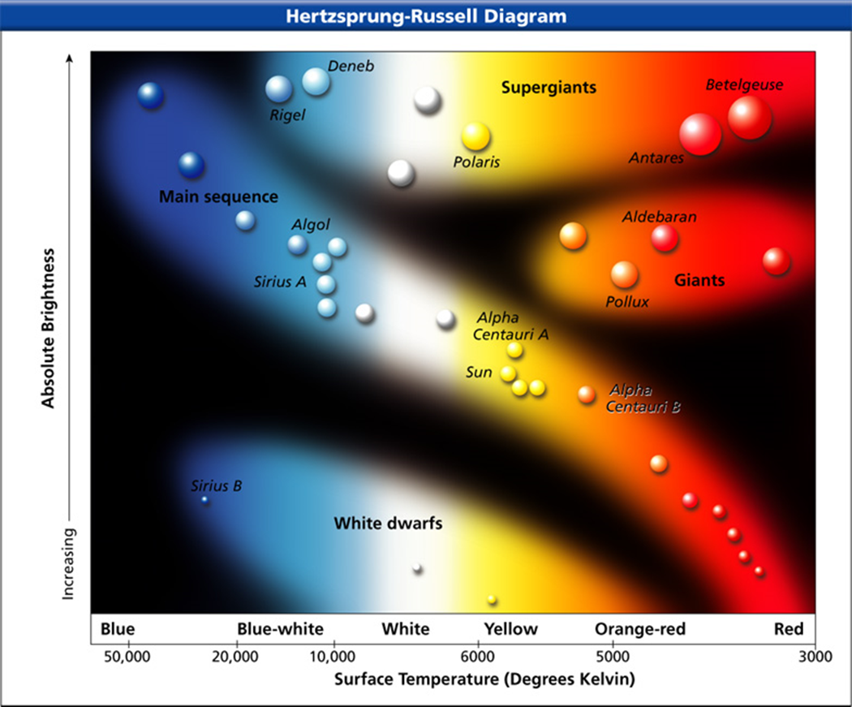
What H-R Diagrams Tell us
Looking at your produced H-R diagrams, what pattern do you notice?
What you should conclude is that though there are many different stars, they are situated into 4 main groups.
These groups are:
White dwarfs (WD)
Main Sequence Stars (MS)
Giants (G)
Supergiants (SG)
Fill in the “Type of Star” column on the right side of the data chart.

Slide 19

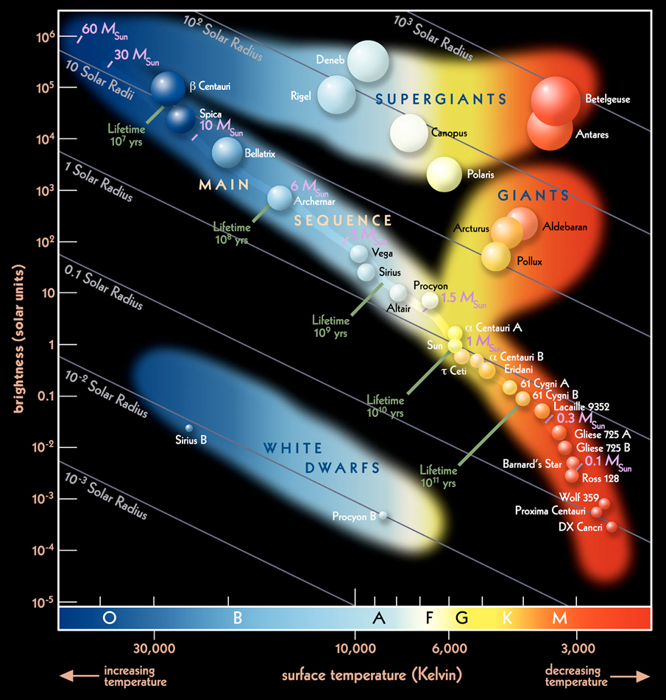
Last. Take the colored pencils and highlight the star groups based upon what color they’d appear in the night sky.
  Outline blue stars in blue
  Outline white stars in black
  Outline yellow with yellow
  Red with red.
Try to make their sizes relative to the size of the star. As you go up the Z Axis, the stars get bigger.
You have 10 minutes.

Slide 20
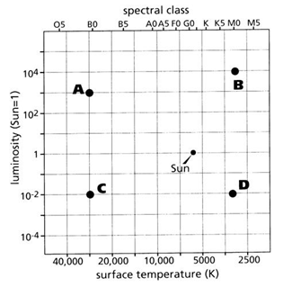
Graphic Analysis
Your growing understanding of the universe is only useful if you can apply your knowledge. Take 5 minutes and take this practice quiz. (for no points)
Stars in which quadrant will have the smallest radius?
Stars in which quadrant will have the largest radius?
Which stars appear the brightest?
Which stars are the dimmest?
Which group would you predict to have the closest properties to Earth?
Which quadrants are the hottest stars in?
What quadrants are the coolest stars in?
Which quadrants would you find blue stars?
Which quadrants would you find red stars?
Stars in which quadrant would have the largest mass?
Stars in which quadrant would have the smallest mass?

